Slide 1
OPSEC in the Digital World
DD MMM YY

Slide 2
Overview
OPSEC Overview
  Critical information and personal information
  Vulnerabilities of Social Media
Pros and Cons of Social Media
Official Navy and Command policies and procedures
The Do’s and Don’ts of Social Media
Geotagging vulnerabilities
In the Headlines
Intro to UTS
  Information being sold to third parties
  Ways to track you
Impacts and Mitigations
UTS Check Up
References
Summary

Slide 3
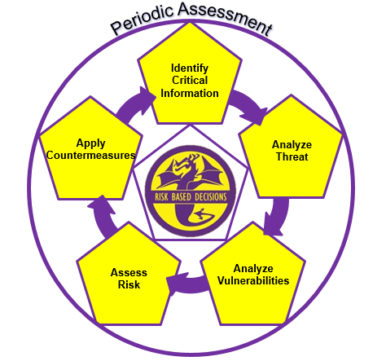
Operations Security
OPSEC is a cycle that identifies critical information, analyzes potential threats and vulnerabilities, assesses risk, develops countermeasures to safeguard critical information, and periodically assesses the effectiveness of the units OPSEC posture.
Notes:
Operations Security: 1. A systematic, proven process by which a government, organization, or individual can identify, control, and protect generally unclassified information about an operation/activity and, thus, deny or mitigate an adversary's/competitor's ability to compromise or interrupt said operation/activity (NSC 1988). 2. OPSEC is a cycle of identifying critical information and subsequently analyzing friendly actions attendant to military operations and other activities to (a) identify those actions that can be observed by adversary intelligence systems, (b) determine indicators adversary intelligence systems might obtain that could be interpreted or pieced together to derive critical information in time to be useful to adversaries, and select and execute measures that eliminate or reduce to an acceptable level the vulnerabilities of friendly actions to adversary exploitation (DOD JP 1994; JCS 1997).
Operations Security Cycle: An analytical cycle that involves six steps: identification of critical information, analysis of threats, analysis of vulnerabilities, assessment of risks, application of appropriate countermeasures and periodic assessment of effectiveness. (NSPM-28).
Completing this cycle will allow commanders to make informed risk based decisions on what information they need to protect and how to protect it.

Slide 4
Critical Information
The unclassified information we must protect to ensure success and is the same information the adversary needs to prevent our success.
Critical information will derive from our essential secrets (Presence, Capability, Strength, Intent, Readiness, Timing, Location, Method).
Not all of the essential secrets of military operations will apply to each and every organization.
Per SECNAVINST 3070.2A, the command’s critical information list (CIL) must be discussed during the onboarding process.
  Discuss what is on the CIL
  Provide or show a copy to newly arrived personnel, or
  Let new member know where to locate or find the CIL
Every command member must be familiar with the organizations Critical Information List (CIL) per SECNAVINST
Notes:
Critical information: Specific facts about friendly (U.S.) intentions, capabilities, or activities vitally needed by adversaries for them to plan and act effectively so as to guarantee failure or unacceptable consequences for accomplishment of friendly objectives.
Critical Information will be derived from the eight operational aspects of operations, shown on this slide. However, the operational aspects are as follows:
- Presence – where your organization or unit is currently located
- Capability – The unique abilities your unit lends to operations
- Strength – The number of units or personnel coupled with the ability to withstand great force
Intent – What your unit plans to do
Readiness – Level of preparedness to execute
Timing – Specific timelines of events
Location – Where your unit will specifically deploy
Method – The way the mission will be executed
Every command must have a CIL. This CIL should be view by the new arrival and also identified where it is located so it can be referred to in the future.
In order to meet SECNAVINST annual training requirements, command members must be familiar with the command’s CIL and information contained.

Slide 5
Personal Information
By comparison, personal information, although doctrinally not considered “Critical Information”, may lead to your association with the military or military operations, and possibly related to operational aspects
Some examples of unclassified information associated with you and your family, that you may consider protecting include:
  Names, photos and details of you and your children
  Usernames and passwords to all accounts
  Social Security Numbers (always)
  Credit card/banking information (NFCU)
  Significant dates (birthdays, anniversaries)
  Addresses and phone numbers
  Everyday schedules (your routine or predictability)
  Travel itineraries, when you’re away from home
Personal information, when divulged and aggregated on the world wide web, could INDICATE your military affiliation and make you VULNERABLE
Notes:
Have you ever heard someone say “that’s an OPSEC violation” or “that’s an OPSEC issue”?
Often times, it may not be an OPSEC related issue or fall within the OPSEC “swim lane”.
OPSEC is an operations function, and unless the disclosure or critical information is derived from the operational aspects, it may fall with one of the security disciplines like information security, personal security, anti-terrorism/force-protection, industrial security etc.
However, disclosing personal information on social media platforms for example, could eventually lead to your association with a command and/or event, and then further lead to the disclosure of critical information when in the aggregate.
Depending on your mission and organization, some personal and personnel information may require a level of protection

Slide 6


Vulnerability
Weakness an adversary can exploit to gain your information
  Vulnerabilities make you susceptible to intelligence / data collection
  Poor security and sharing too much information are common, easily exploited vulnerabilities
  Social media posts, Tweets, Snapchats, YouTube comments can expose important information to potential adversaries and remains a very common vulnerability
Notes:
Vulnerability:
A weakness the adversary can exploit to get critical information. A vulnerability is anything that makes your critical information susceptible to intelligence collection.
Your Essential Elements of Friendly Information (EEFI)/Critical Information, threat analysis, and considering the adversaries perspective will point to the vulnerabilities in the planning process or when completing an assessment.
A vulnerability is any instance in which you expose your critical information to consumption by the general, unfiltered public. You must assume that your adversaries are apart of the public.

Slide 7
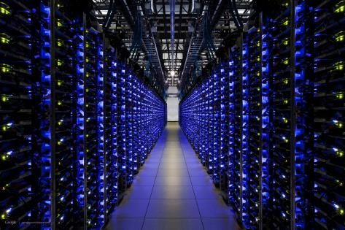
Your Social Media Profile
What do you display in your social media profiles?
  Your command
  Job title
  Designation / rating
  Past, present or future location
  Current or past activities
  Associations
  Likes and dislikes
  Birthday
  Favorite pet
  Relationships
  Loved ones
  People you trust
  Are any of the above associated with your account security questions or passwords? Does it pose a risk?
Notes:
Does your profile say you’re in the Navy? Is that sensitive information? Does your profile state you’re in a job field that requires a security clearance? Does that pose a risk? Is your birthday PII? Does that pose a security risk? IS your password based off anything in your profile?
More information, means the possibility of data aggregation, means adversaries might be able to trace your personal information to the command you’re stationed. Is this a risk?

Slide 8

Social Media in the Navy
Social Media allows people to network, interact and collaborate to share information, data and ideas without geographic boundaries.
The Navy has an obligation to provide timely and accurate information to the public; keep our Sailors, Department of the Navy civilians and their families informed; and build relationships with our communities.
We all play a crucial part in these communication efforts, both on and off duty.
Is an accepted risk but only a low vulnerability when:
  Users are informed and understand social media and OPSEC policies
  Use common sense
  Understand the difference between what to share and what NOT to share
  Users are aware of the information aggregation capabilities
The ignorant or apathetic user is the Vulnerability!
Notes:
- The Navy’s Social Media Handbook is the official publication used by the Navy regarding social media. It lists policies, instructions, guidance, and much more regarding social media. It can be found by a an easy google search “Navy Social Media Handbook”
-Department of Defense Instruction (DoDI) 8170.1 discusses the use of Internet-based capabilities (IbCs) and Applications, such as social media, and provides guidelines for their use. The instruction acknowledges IbCs, including social media, are integral to operations across the DoD. It also requires the NIPRNet be configured to provide access to IbCs across all DoD components while balancing benefits and vulnerabilities
-Official social media sites allowed for DoD commands listed in https://dodcio.defense.gov/Social-Media/.
-Apps such as Tik Tok, What’s APP may not be used to discuss any official DoD information
-Most Internet-based Capability (IbC) providers require acceptance of Terms of Service (ToS) agreements before activating accounts, however, standard ToS are often inappropriate for acceptance for official use by Department of Defense (DoD) employees and other authorized users. Therefore, the DoD only agrees to ToS that have been reviewed, modified if necessary, and approved for DoD-wide application by the DoD Chief Information Office (CIO).

Slide 9
Pros & Cons of Social Media
  Pros
For the Individual
  Entertaining
  Maintain Relationships
  Network
  Centralized Information
  Collaborate
For the military
  Recruitment
  Public Relations
  Connect service member, family members & the public
  Solicit ideas and feedback
  Official news and notes
  Build relationship with communities
Cons
Unsecure, unencrypted communications
Unrestricted access
No user/identity authentication
Easy source of PII & CI
Malicious code/virus
Prime target for data aggregation
Cybercriminals
Potential to compromise certificates
Notes:
Individual social networking is a great tool to network and collaborate. Social networking sites are entertaining and engaging for users.
-Social media, when used effectively, presents unequaled opportunities for you to share the Navy story in an authentic, transparent and rapid manner while building richer, more substantive relationships with people you may not have reached through traditional communication channels
- However, there are several Pros and Cons when using social media sites. Remember, just because it’s printed on social media, it doesn’t meat it’s the truth or real. There is an overwhelming amount of misinformation or “fake” news scouring the internet, and much resides on social media sites.

Slide 10
Your Security Clearance
The following is a security awareness statement signed by the Chief of Security, Pentagon Chief Information Officer, OSD Network Directorate:
  Social sites risk security clearance. If you hold a security clearance or if you ever want to apply for one, be mindful of your postings and contacts online, particularly on social networking sites such as Facebook and Instagram.
  These sites pose risks to gaining and keeping a security clearance. Question 14 of the National Security Agency Questionnaire (SF-86) asks for names of your relatives and associates.
    The term associate is defined as any foreign national that you or your spouse are bound by affection, obligation, or close and continuing contact.
Be mindful of all contacts, associates, “friends” and followers on your personal social media platforms. Be prepared to discuss the above during security clearance interviews.
Notes:
SF-86– required to be granted a security clearance. Associate is anyone that you or your spouse have close or continuing contact with. This includes “friends” on social media platforms. Who are your friends and associates?
Do you know who ALL of your social media friends are? Before you click “accept” ensure you know the risk you are taking.

Slide 11
Social Media Cost
Nothing in life is free!
If you are not the consumer…….Then you’re the product!
How much is your information worth?
Mark Zuckerburg (Facebook) became the world's youngest self-made billionaire by selling your information (if you have or had a Facebook account)
How is this legal? Read the terms of service, understand what you agreed to
The terms of service for “Official” command accounts is not the same as personal accounts
Read terms of service for ALL social media platforms and APPs
Are your friends and family okay with you sharing their information?

Slide 12
Consider the Terms of Service
We use the data we have - for example, about the connections you make, the choices and settings you select, and what you share and do on and off our products - to personalize your experience.
We collect the content, communications and other information you provide when you use our products, including when you sign up for an account, create or share content, and message or communicate with others. This can include information in or about the content you provide (like metadata), such as the location of a photo or the date a file was created.
We collect information about the people, pages, accounts, hashtags and groups you are connected to and how you interact with them across our products, such as people you communicate with the most or groups you are part of. We also collect contact information if you choose to upload, sync or import it from a device (such as an address book or call log or SMS log history).
Notes:
This is only half the list of Facebook’s terms of service! You freely give up a lot of information to not just other users, but to Facebook itself. Does this create more of a vulnerability? Does this increase risk?
Many of the ToS on other platforms read very similarly. Be aware.
“If you’re not paying for it, you’re not the customer; you’re the product being sold”.

Slide 13
Privacy & Security
Keep up with the latest security and privacy settings for your social media sites and applications (Apps)
Protect your profile
  Only allow trusted people to view your profile
  Limit others to search your profile
Protect your posts
  Only allow trusted people to view your posts
  Know who can see what you post and when
Understand what friends of your friends can see
Change your password frequently and make it complex
Always log out of your account when not using it
Notes:
Privacy settings are available on most sites and vary depending on the specific sites privacy policy.
Facebook’s current privacy settings are now included in the rights that you grant Facebook in regards to what they are able to do with your information, as well as what applications linked to the site are able to obtain.

Slide 14
Social Engineering
Manipulating individuals into divulging confidential or personal information for fraudulent purposes.
Do not provide critical or personal, sensitive information to anyone on social media sites
Trust by exception
  Be suspicious of ALL online contacts
  Verify the authenticity of a friend request
  If unsure, do not trust
If it appears too good to be true, it probably is
Be aware of the different ways in which adversaries will use social engineering techniques, for example, “phishing” or using appealing photos.
Notes:
Do not trust who you cannot see and verify. It is not hard to establish fake accounts and to fake information to target people. There are adversaries out there who are targeting you with social engineering. It is easy, it’s cheap, and it is an effective tool for gathering information and exploiting vulnerabilities in both the cyber, and real world.

Slide 15
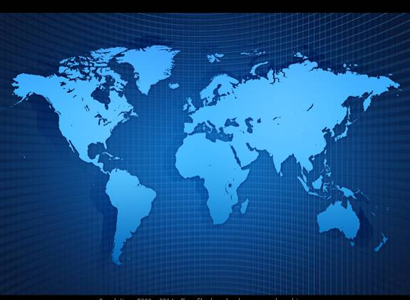
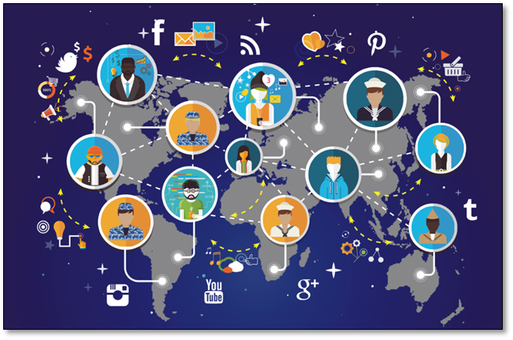
DO’S & DON’TS of
SOCIAL NETWORKING
Notes:
Do’s and Don’ts of Social Networking and using social media platforms
An outline of some basic points that a user should follow to make their use of the internet safer.

Slide 16
Do – Use Common Sense
When posting, post in PAST tense
Be mindful of timelines
  Timelines can quickly reveal patterns and routines when aggregated
  Understand your audience on the world wide web (www). You are potentially posting to millions, regardless of your privacy settings!
  Always remember to protect other’s information as if it were your own.
  Never post someone else’s picture, itinerary, location and so on (unless given permission). If they wanted that information posted on the internet, they will do it themselves.
Assume the information you share will be made public, and shared again
Notes:
Always make it a habit to post PAST tense. For example:
“Leaving for our week vacation in OBX” versus “Had a wonder week in the OBX”. A thief can use the first post to their advantage, knowing you won’t be home for the week where as a Past tense post provides a the same thief nothing!
Be mindful of timelines
Timelines can quickly reveal patterns and routines when aggregated
Understand your audience on the world wide web (www). You are potentially posting to millions, regardless of your privacy settings!
Always remember to protect other’s information as if it were your own.
Never post someone else’s picture, itinerary, location and so on (unless given permission). If they wanted that information posted on the internet, they will do it themselves.

Slide 17

Do – Verify
Verify All Friend Requests
  Social engineering starts with a friend request
Adversaries can get the data from:
  Free people search engines
  Other social media sites
  Your posts/profile
  Your friends posts/profile
Do Not Trust Who You Cannot See
Notes:
Do not trust who you cannot see and verify. It is not hard to establish accounts and to fake information to target people.
How do you verify? It’s easy, call them.

Slide 18
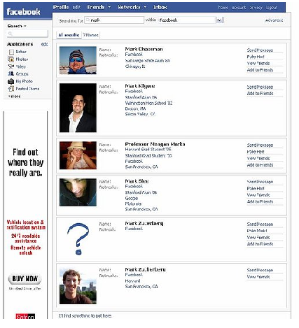

Do – Utilize Privacy Settings
Customize available settings to be as secure as possible
“Everyone” may be accessed by anyone with access to the internet
Check settings often, especially after software updates
Social media sites change settings frequently
WARNING:
While you should always use privacy settings, you can’t fully rely on them to keep your information private
Notes:
Privacy settings are available on most sites and vary depending on the specific sites privacy policy.
Facebook’s current privacy settings are now included in the rights that you grant Facebook in regards to what they are able to do with your information, as well as what applications linked to the site are able to obtain.
There are over 100 different security settings on Facebook.

Slide 19

Do – Use Discretion
Consider the information you make available
Does your post, photo, or video serve a valid purpose?
Consider how comments, photos and videos can be interpreted or manipulated
Understand your digital foot print and audience
Once posted, you completely lose control of the information
Notes:
Always consider how the information that you make available can be used against you.
What image does your social networking profile give of you?
What messages are your posts actually saying about you?
Also understand your post today could actually affect you years down the road

Slide 20

Do – Be Informed
Be an informed user of social media. You wouldn’t drive a car without a drivers license, so know how to “drive” on your social media platform
Review how much personal information you broadcast
Be very careful about what details you post
Understand data aggregation issues and capabilities
Learn all the security or privacy settings, and keep them up to date as software updates occur…. and may change your settings.
Are you willing to accept the risk?
Notes:
Be an informed user. Know the terms of use, the changes to the site, and all of the different settings that are available. Make your site as secure as possible, understand that data collection is the job of many– from marketing campaigns to adversaries.
Regardless of settings, never post details– details make you vulnerable.

Slide 21
Don’t – Rely on Privacy Settings
Don’t…
  Depend on social media platform security settings to protect critical information
  Accept the Terms of Service without reading and understanding
  Assume settings are correct
  Just accept upgrades or site changes without understanding the changes
  Assume only authorized persons will view your information
WARNING:
While you should always use privacy settings, you can’t fully rely on them to keep your information private
The posting of critical information is unauthorized
…even in closed, private groups
Notes:
Never forget- the true purpose of social media from the creators
There are many instances where your information that you thought was private, really isn’t.
Security isn’t perfect, and in many cases, it’s not even adequate because it’s not a priority for the owners of the social media platforms.
Straight from the Facebook statement of rights & responsibilities- “USE AT YOUR OWN RISK. We do not guarantee that Facebook will be safe or secure.”
Also remember security is not privacy when it comes to settings

Slide 22
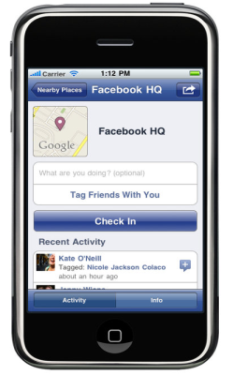


Don’t – Check-In
  Geotagging: Location /GPS data embedded in photos
Default feature in most smart phones and digital cameras
  Latitude/longitude/altitude
  Device details and access to information depending on what you accept
Information can potentially be retrieved from posted digital photos
Notes:
Geotagging: Location /GPS data embedded in photos.
Location / GPS settings are normally defaulted ON in most smart phones and digital cameras. Most users leave this feature on because it also provides mapping instructions while driving and provides a host of other benefits. Do understand that Latitude/longitude/altitude will be imbedded in digital photos…….where the photo was actually taken.
Device details and access to information may also be enabled depending on the ToS and what you accept on different applications
Information can potentially be retrieved from posted digital photos

Slide 23
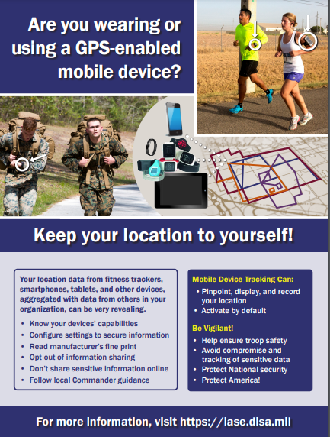
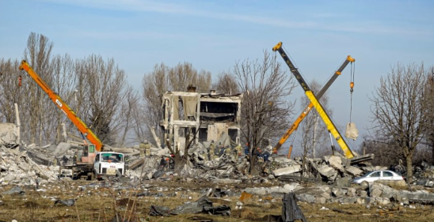
Don’t – Geotag
Smart watches, software and many downloadable apps can track movements
Depending on your mission, can pose a security risk and vulnerability
In 2022, Russian soldiers holding a New Year’s eve party in occupied Ukraine were targeted by the Ukrainian military based on geo-located social media postings resulting in the death of 200 to 500 soldiers.
Notes:
Here is a costly example of geotagged data used by an adversary
Though this technology is relatively “old” it is still a major vulnerability. Many people still do not know about geotagging and the risks they take when they post digital images online.

Slide 24

Don’t – Discuss Details
Don’t…
  Post anything you would not tell directly to the enemy
  Ever post private or personal information – your “real” friends probably already know this information
  Ever post command critical information
If It Has To Be Protected, Protect It
Notes:
Don’t discuss or post details regardless of security settings. There is no truly secure computer with access to the internet- keep that thought in mind at all times and keep details to yourself.

Slide 25

Don’t – Make the Headlines
Details in photos- capabilities, location and timing of operations
USAF Nuclear Security Force posting sensitive information
Unidentified Aerial Phenomenon (UAP) videos
F-35 crash video
Notes:
-These are just a few examples. I’m sure we’ve all heard stories of Sailors getting in trouble by posting inappropriate things on social media. Parties, political thoughts, etc. Selfies onboard a ship with critical information or sensitive equipment in the background.
What you post on facebook could negatively affect your career! It could also negatively affect your personal life.

Slide 26
Intro to Ubiquitous Technical Surveillance (UTS)
The modern digital landscape requires we change how we think about OPSEC because of Ubiquitous Technical Surveillance (UTS).
UTS refers to the vast array of data being collected by smartphones, internet browsers, and 3rd party services such as hotels, airlines and the Internet of Things (IOT) devices.
Vast troves of personal information is being collected, aggregated and exploited by commercial entities and freely sold online.
This industry, also known as ADTECH, is the primary driver of the explosion of artificial intelligence (AI) and machine learning (ML) in modern society.
These advancements have allowed advertisers to understand deeply personal information about an individual. Aggregated across multiple members of a unit and along with traditional OPSEC threats – an adversary can glean a significant amount of information.

Slide 27
Examples of UTS Threats
In 2018, the BBC reported that Twitter users had discovered the locations of US Military installations overseas, by using geolocation data from fitness trackers.
In 2019, the Swedish Newspaper, Dagens Nyheter, was able to purchase commercial data as was able to identify and track members of the Swedish National Police, the Armed Forces & the Swedish National Defense Radio Establishment.
In 2021, a group of US Senators asked companies such as Google & Facebook about what foreign companies they sell user data to – as a concern that foreign intelligence services could exploit this data.
Throughout 2022, open source intelligence firm Bellingcat collected and analyzed data collected from Russian military units operating in Ukraine to build unit patterns of life, locations and movements; building a case for Russian war crimes.

Slide 28

What Type of
Information is being Sold?
Web Browsing & Search History
  Travel bookings
  Hotel stays
  Online purchases
Location History
  License plate scanners
  Wifi devices on networks
  Real-time monitoring of Persons of Interest
Personal Data
  Addresses
  Real estate purchases
  Public records

Slide 29
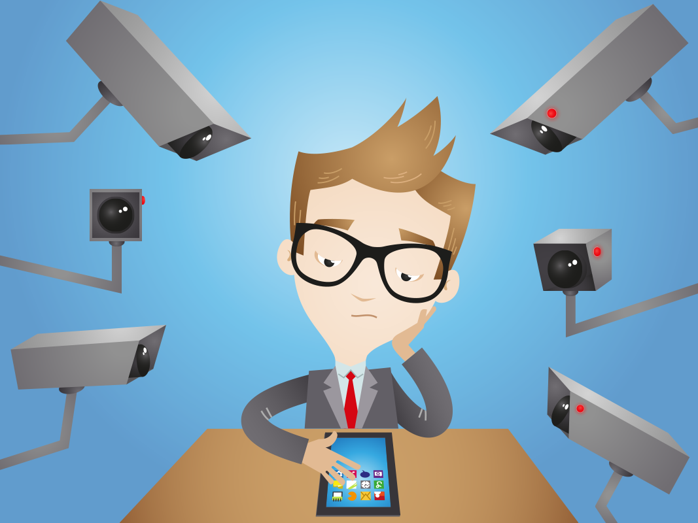
How do third parties keep track of you online?
There are a myriad of ways that companies track you online, but the following are some of the most common:
  AdID
  Apps
  Cookies and online browsing
  Social media
  Geolocation
  Logins (via facebook, google, etc.)
  Hardware identifiers (MAC, IMEI, etc.)
  Email / phone number

Slide 30
Smartphone Applications
Smartphone applications are the primary concern. Seemingly harmless apps vacuum up as much information and sell it. For example, "The Brightest Flashlight" iPhone app was found to be selling precise user location data and device IDs without disclosure.
Your phone is constantly monitoring everything around it, and applications can record, store and sell it depending on the user agreement.
Mitigations:
  Ask yourself – do I need this app? Can I use the web version? (Facebook app vs. browser)
  Minimize the ones you do have and regularly delete old ones
  Look up the app you are downloading, read reviews when possible
  Logout of apps when you aren't using them on your phone
  Manage permissions closely
  Avoid using commercial apps for Navy business, even innocuous uses like social gatherings off base. If you do use them, look them up.

Slide 31
TIKTOK
Chinese Internet technology company "ByteDance", headquartered in Beijing and boasting 110,000+ employees, rakes in over $50 billion a year from its flagship short-form video application TikTok.
A U.S. based intelligence and security strategy company recently offered its findings of TikTok. Their analysis concluded that TikTok is a military espionage tool that scrapes exploitable data from a smartphone, to include GPS data, who you communicate with, and logs every keystroke the user enters via the application.
All of that data is transmitted/stored on ByteDance's servers (located in China).
Analysis aligns with comments vocalized by the FCC Commissioner in July 2022, who stated that U.S. military personnel who use TikTok create a “national security risk”.
Further, Britain's Ministry of Defense just banned TikTok from its agency's phones due to “significant security concerns”.

Slide 32
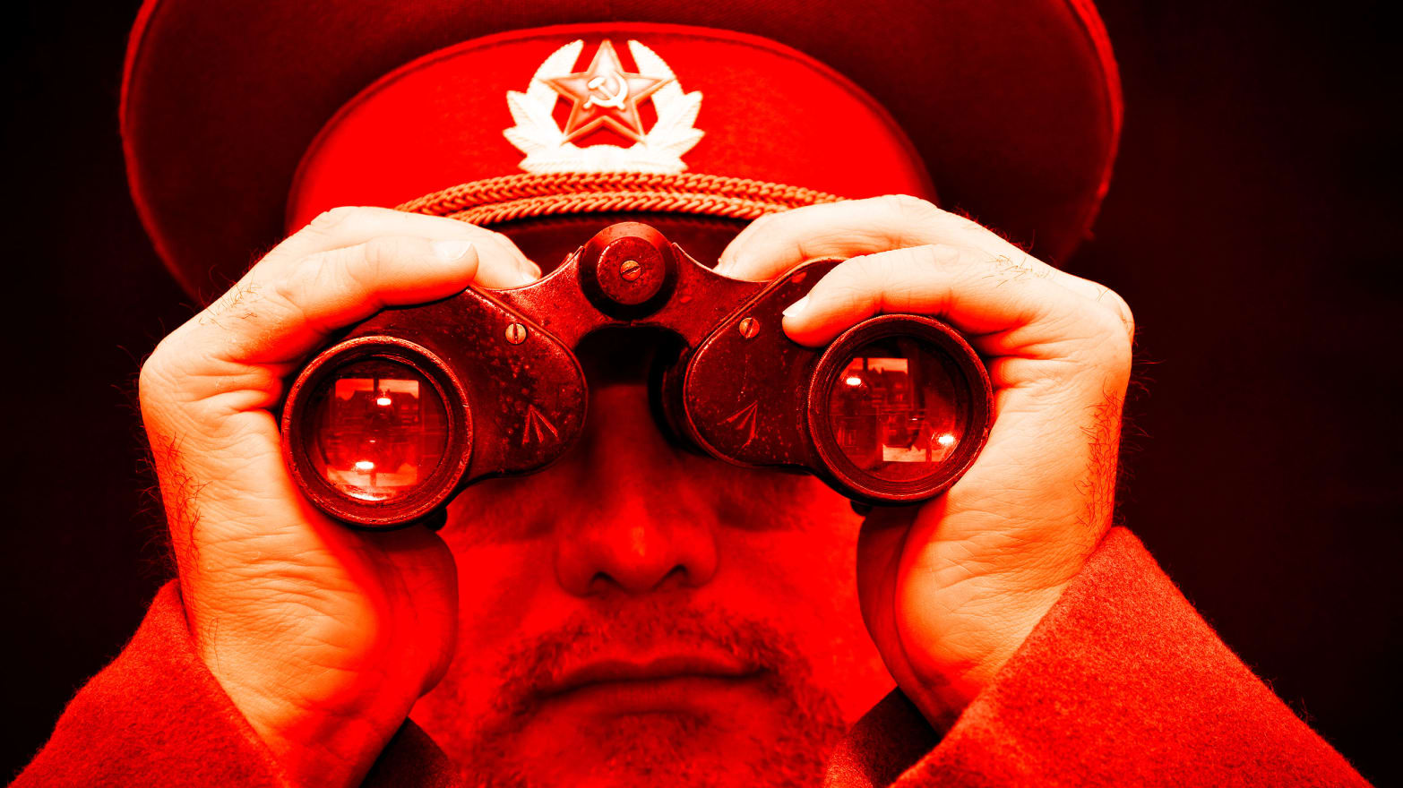
Operational Impact
Adversary able to …
  Predict future movements
  Unmask capabilities and intentions of activities
  Target key individuals or groups to disrupt missions (financial disruption, insider threat recruitment, etc)

Slide 33
Understanding Mitigations
In the modern digital environment, it is impossible to avoid all commercial tracking – but prioritization can help guide mitigation strategies.
Use the OPSEC process to determine the risk of UTS for your command's critical information list.
Take a moment to consider the adversary's perspective.
Education remains the most important aspect of this problem – if Sailors don't understand the problem – they can't be part of the solution.
Mitigations can't be implemented overnight; they need to be planned and executed ahead of time to take effect.
Smartphones are the biggest challenge to stemming data flow.
Contact the NOST with detailed questions or specific challenges.

Slide 34
UTS Check-up
Disable AdID or reset regularly on primary smartphone.
Use a privacy-oriented browser or use anonymous browsing
Delete cookies regularly or use an ad-blocker
Consider the use of a VPN
Consider the use of encrypted email
Avoid using unencrypted or social media provided messaging apps.
Consider using encrypted cloud storage instead of services like Google Drive
Consider removing social media apps and using the online version via the web browser instead
Turn your smartphone off and keep it away from sensitive evolutions or meetings.

Slide 35
OPSEC in the Digital World Summary – One Navy Team
  Leaders
      Communicate expectations
      Outline policy, making sure teams know what they can and cannot do online
  Sailors and Navy Civilians
      Consider what messages are being communicated, by what means they are communicated, and how they may be received
      Do not create or share content that is inconsistent with Navy values or standards of conduct: Protect unclassified, critical information
      Understand that all your digital activities are being tracked and sold by third parties
      Disable geolocation services, apps and devices while in operational areas
      Avoid using commercial apps for Navy Business
  Operations Security (OPSEC) Officers
  Ensure everyone upholds OPSEC online just as much as you do offline
  Bottom Line: Think before you use
  How can the information I release affect the
  Navy, the command, my loved ones, myself, and my family!
Notes:
-Large commands have full time Public Affairs Officers, smaller commands do not, but have PA reps fulfilled by collateral duty. Regardless,
almost all commands have either an official .mil website and/or a Facebook page managed by an administrator, and every command should have a public release review process in place, and that includes an OPSEC review.

Slide 36
References
Department of Defense Instruction (DoDI) 8170.01, 2 January 2019, Online Information Management and Electronic Messaging
SECNAVINST 3070.2A, 9 May 2019, Operations Security
NTTP 3-13.3, December 2022, Operations Security
SECNAVINST 5720.44C W/CH-2, 21 February 2012, DON Public Affairs Policy and Regulations
Navy Social Media Handbook (2023)
Department of Defense Memo 30 Jan 2019, Use of Geolocation-Capable Devices, Applications and Services

Slide 37

Contact Information
Your Logo here
Your Command OPSEC Program Manager information here.
NAVY_OPSEC@us.navy.mil
757-203-3656
NAVAL INFORMATION FORCES
ATTN: NAVAL OPSEC SUPPORT TEAM
115 LAKE VIEW PARKWAY
SUFFOLK, VIRGINIA 23435

